Slide 1

Megaminx
MMR 2020 – Group 3

Slide 2
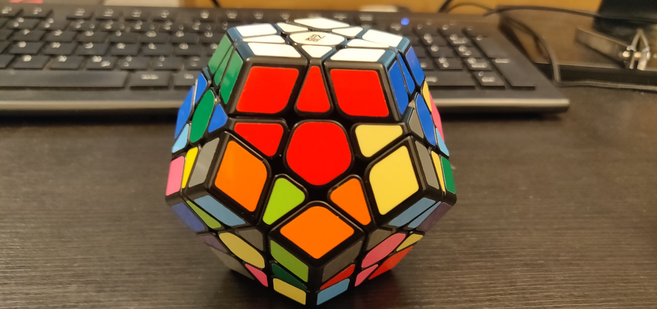
Goals
ReminderGoal 20

Slide 3
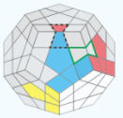
ALGORITHMS
SP2
(dl l dl‘ l‘ dl‘) (f‘ dl f)

Slide 4
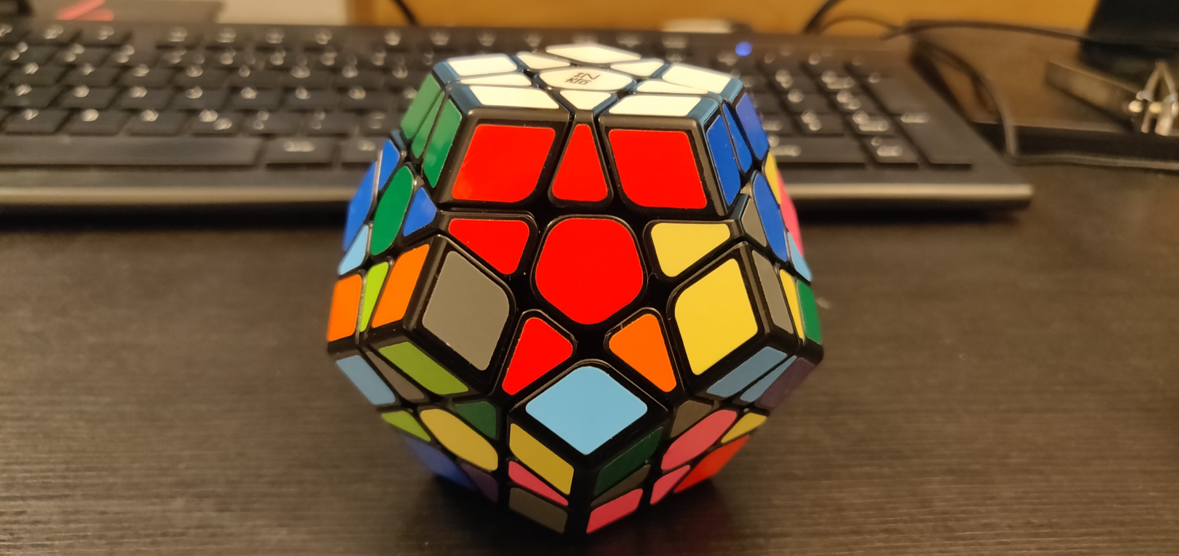
Goals
Goal 21
Moves: all

Slide 5
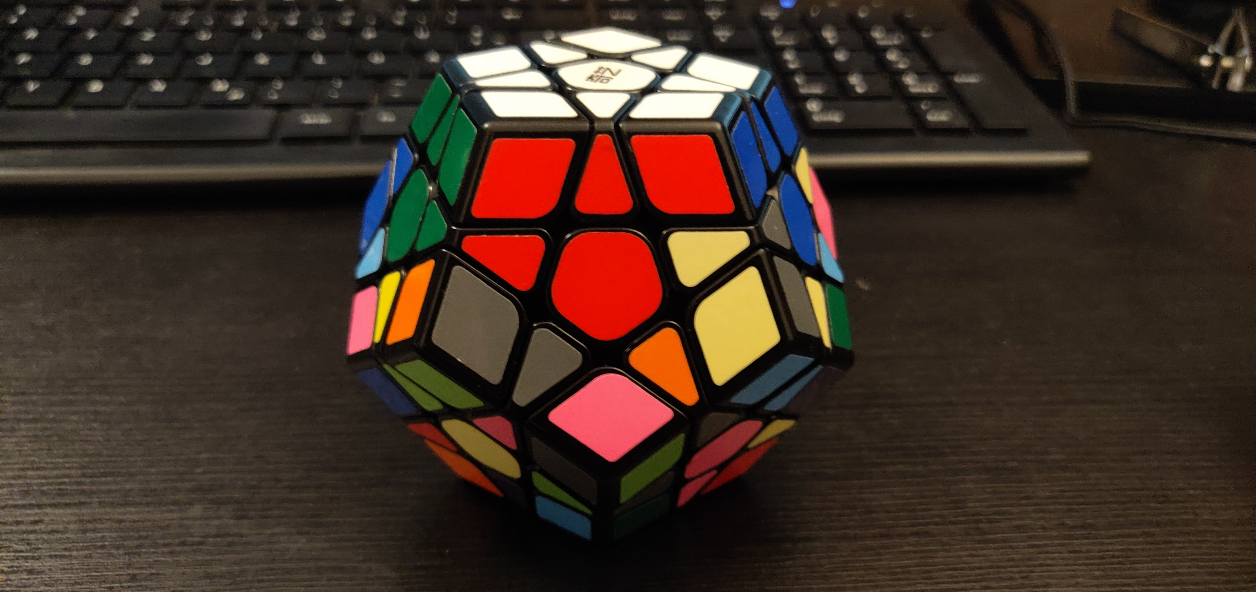
Goals
Goal 22
Moves: Sp2

Slide 6
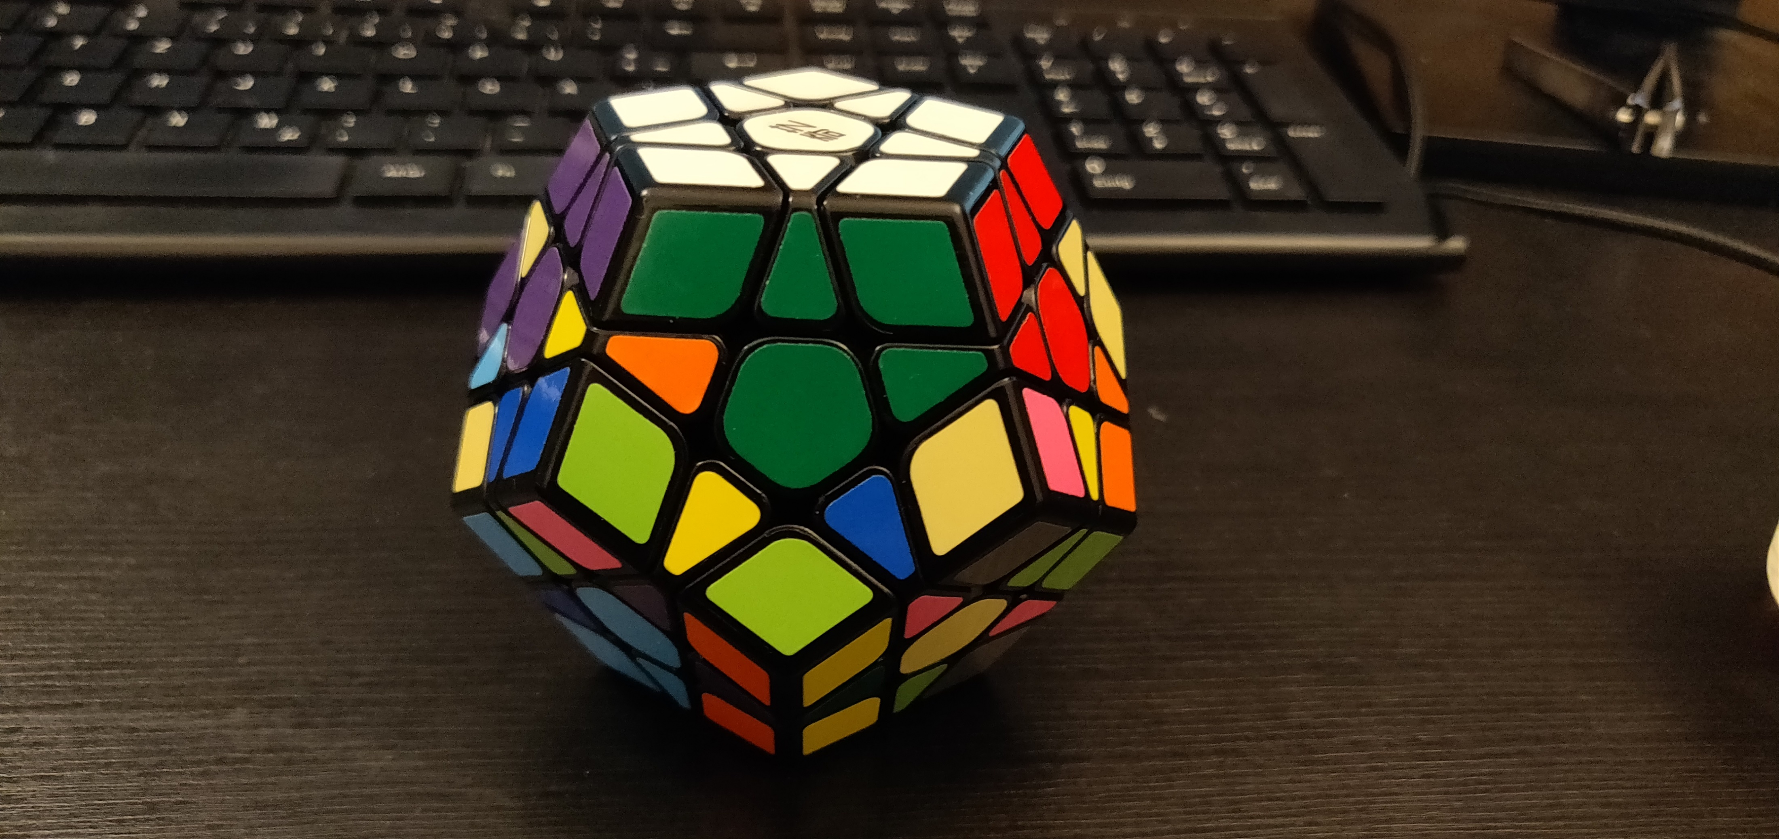
Goals
Goal 23
Moves: -r_v

Slide 7
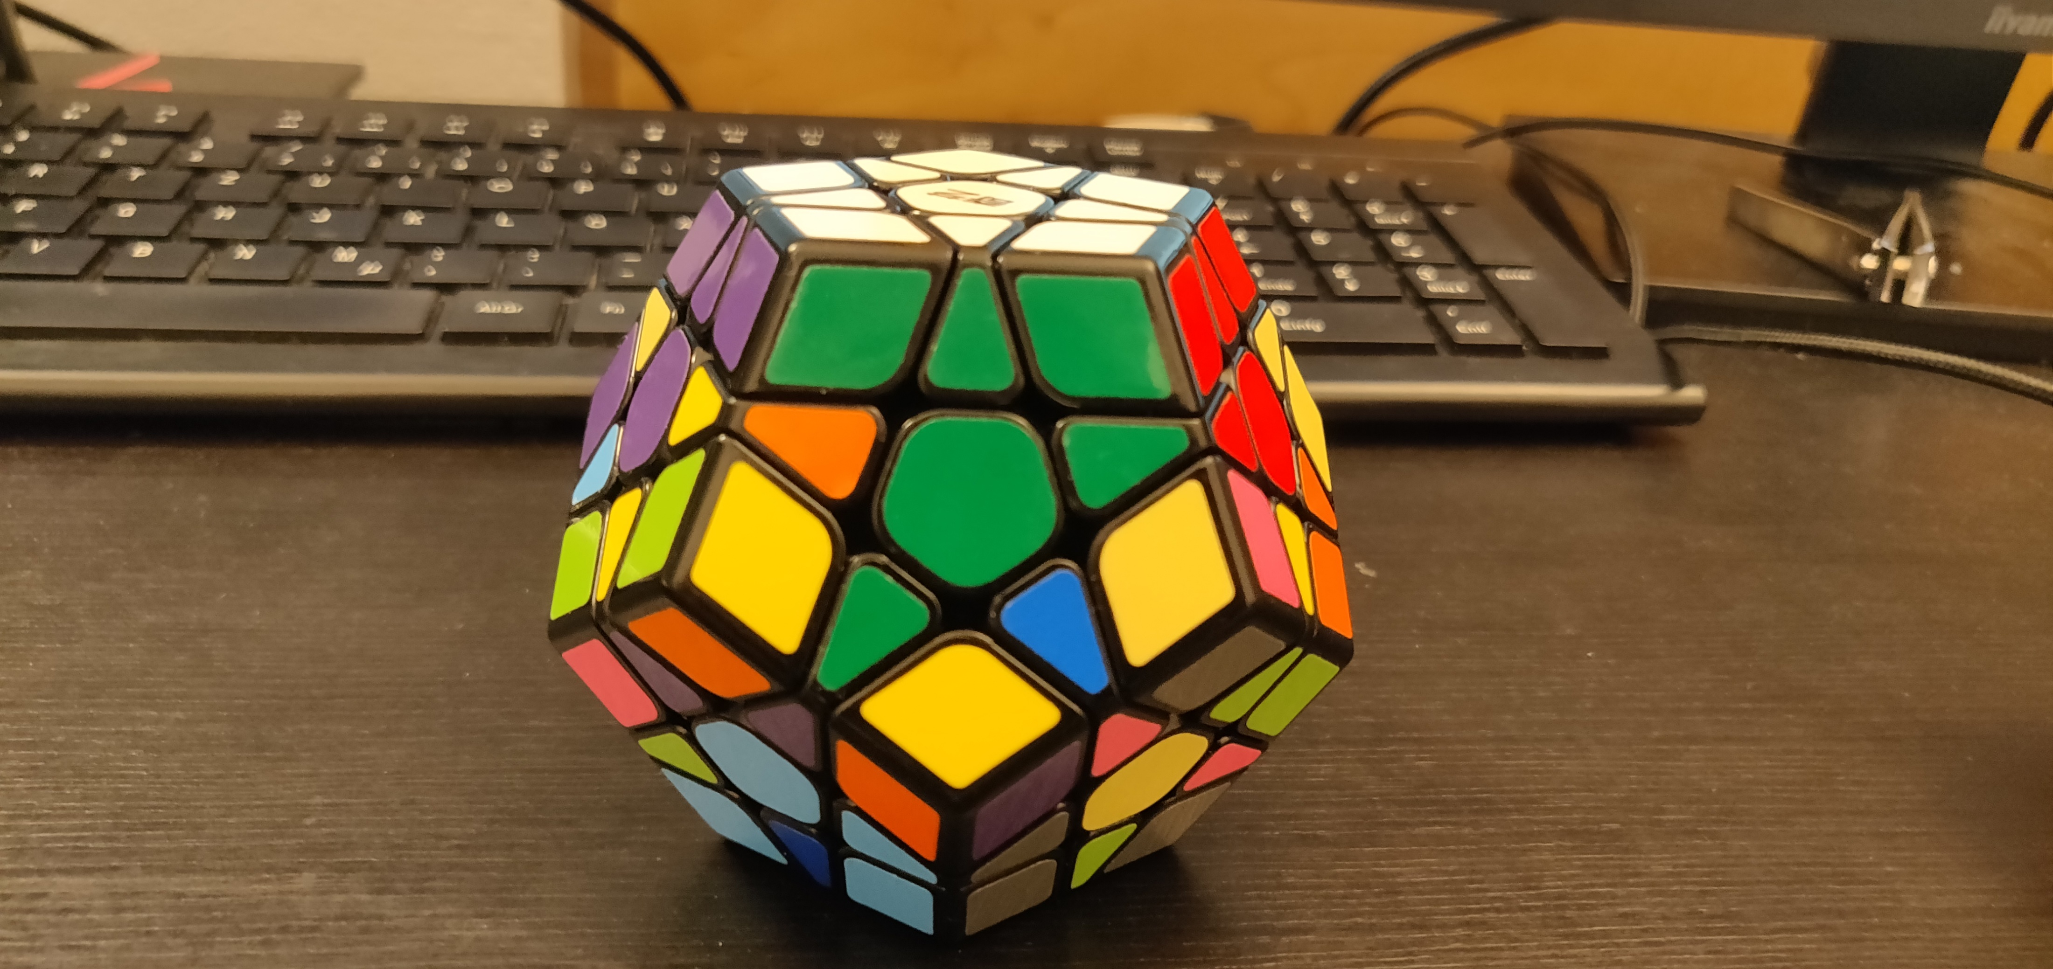
Goals
Goal 24
Moves: all

Slide 8
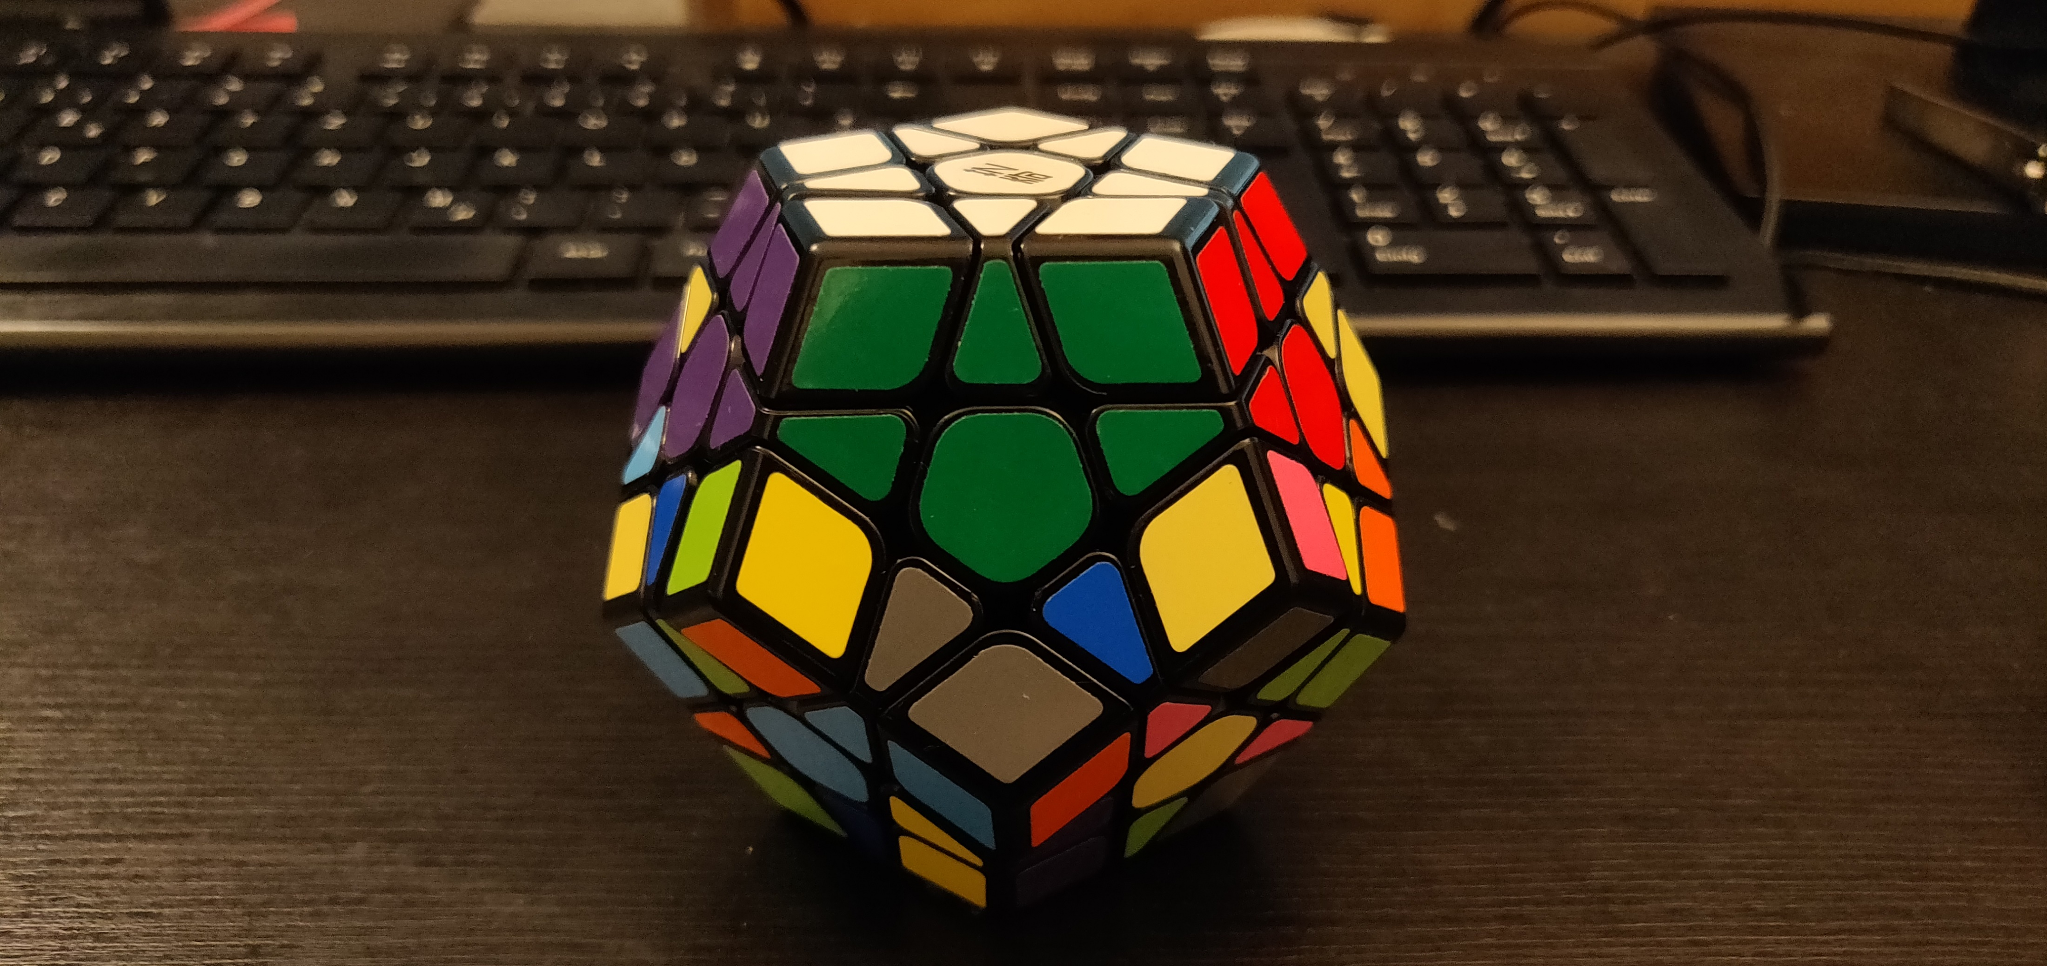
Goals
Goal 25
Moves: Sp2

Slide 9
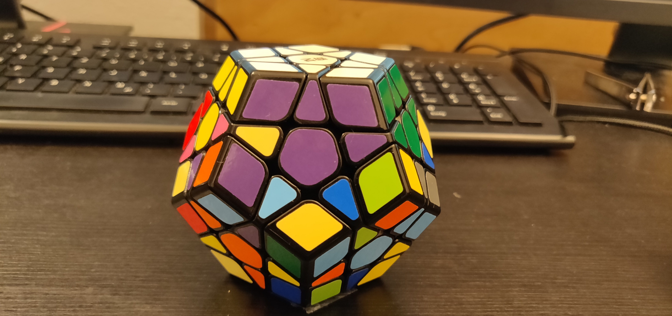
Goals
Goal 26
Moves: -r_v

Slide 10
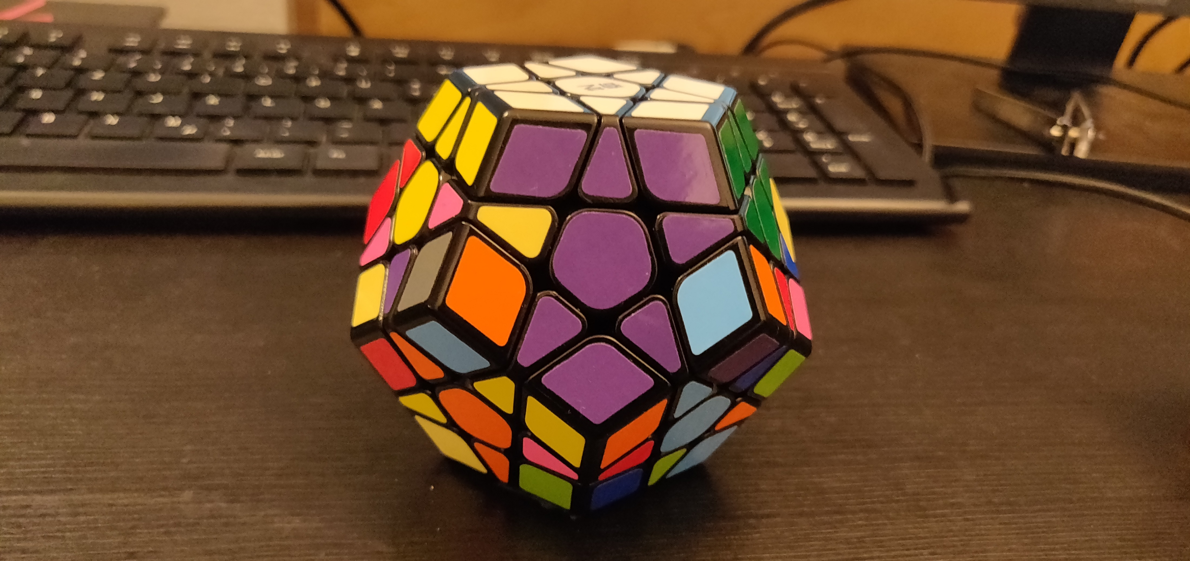
Goals
Goal 27
Moves: all

Slide 11
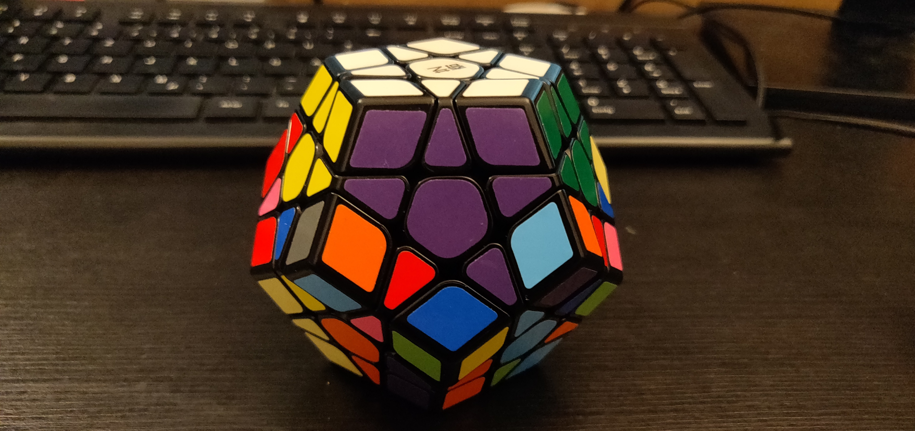
Goals
Goal 28
Moves: Sp2

Slide 12
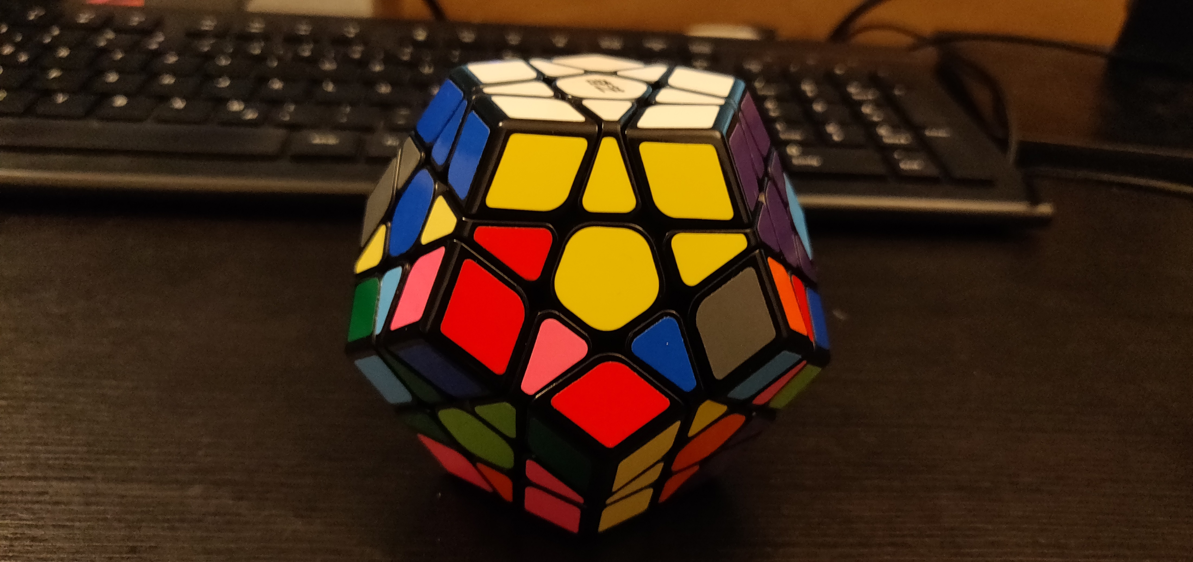
Goals
Goal 29
Moves: -r_v

Slide 13
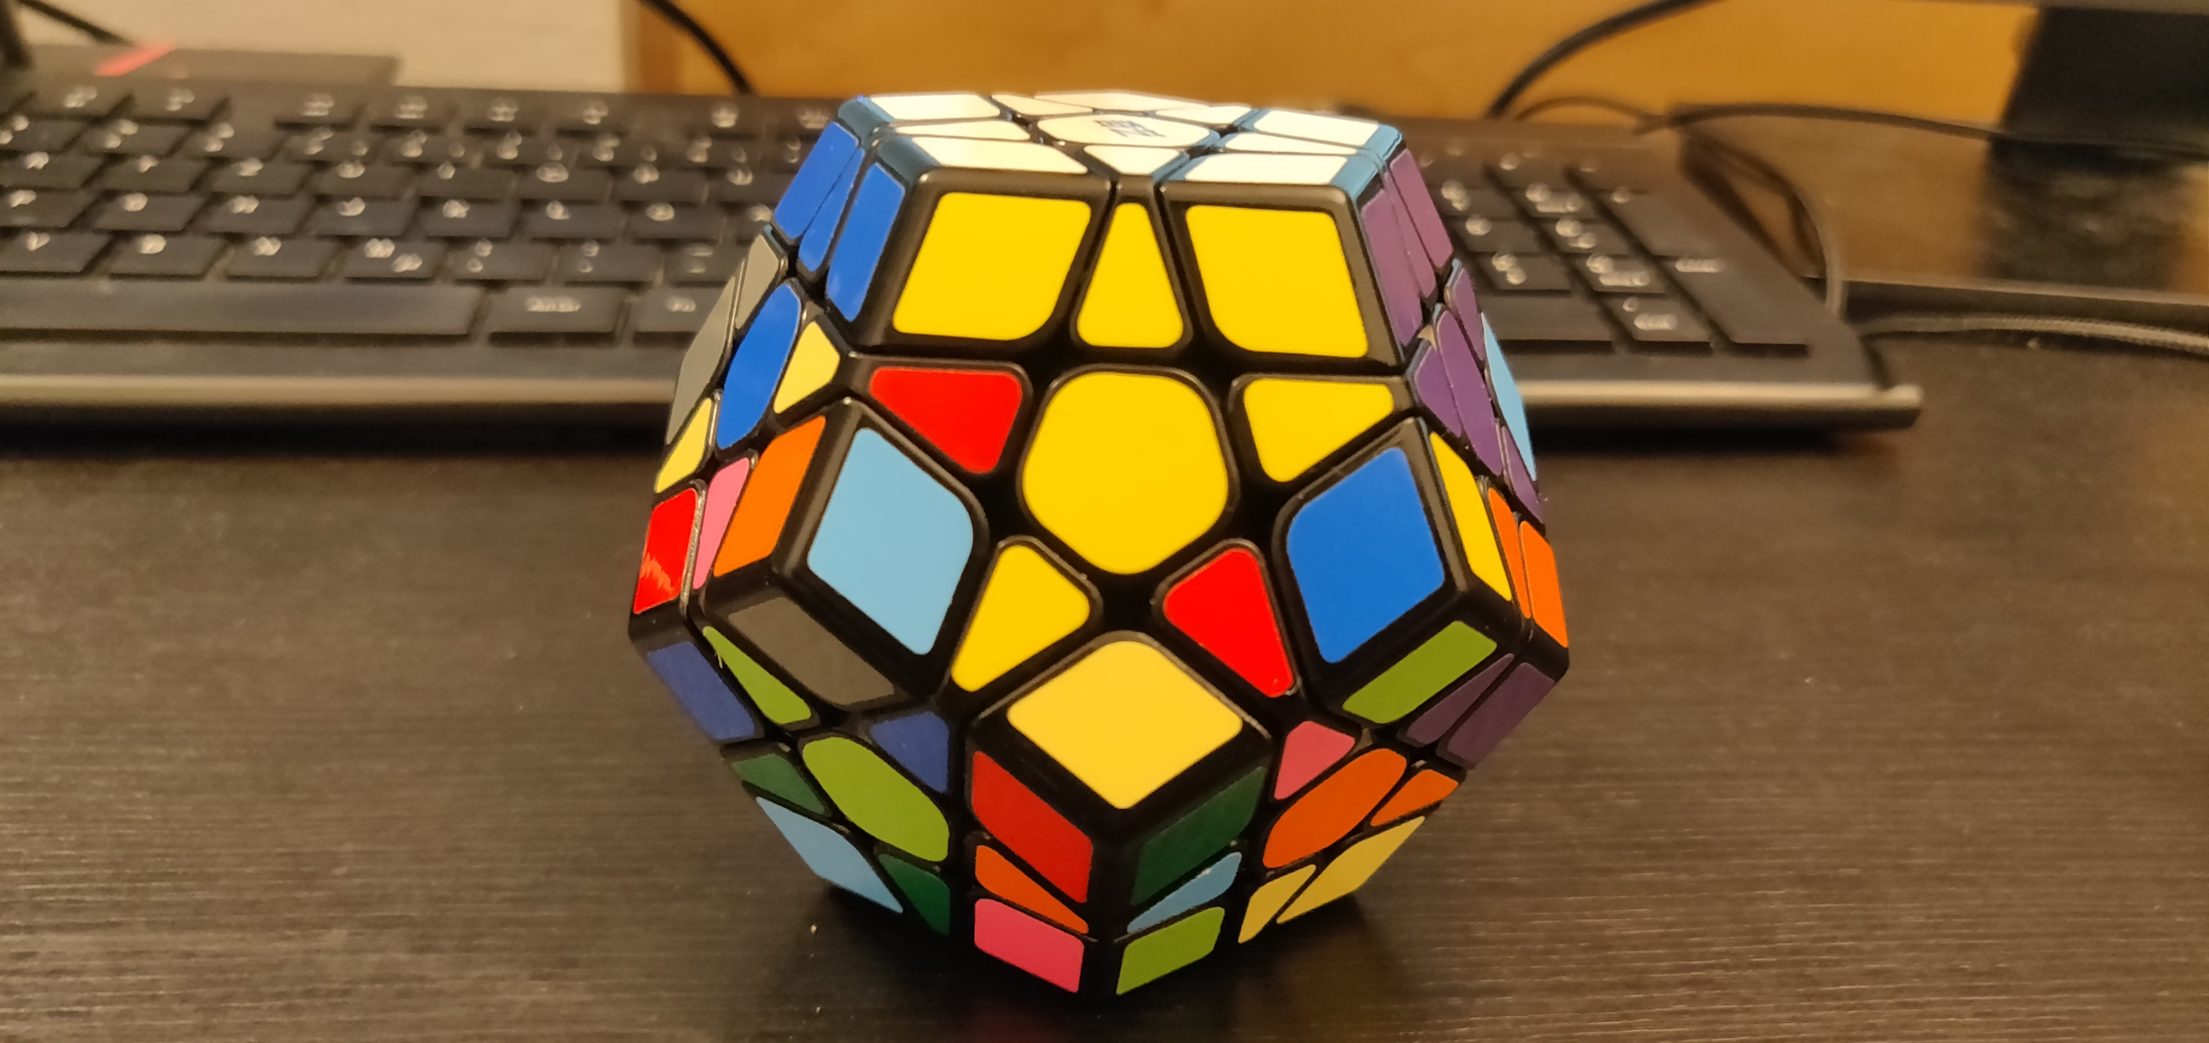
Goals
Goal 30
Moves: all

Slide 14
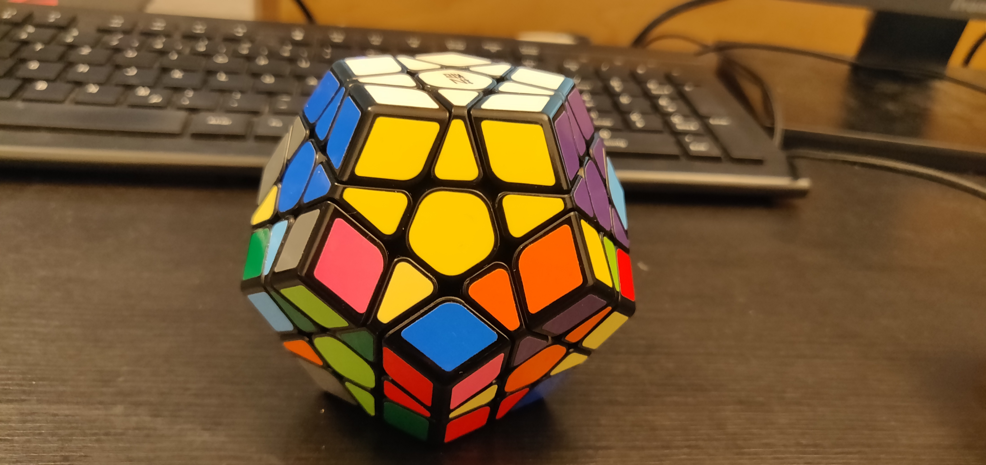
Goals
Goal 31
Moves: Sp2

Slide 15
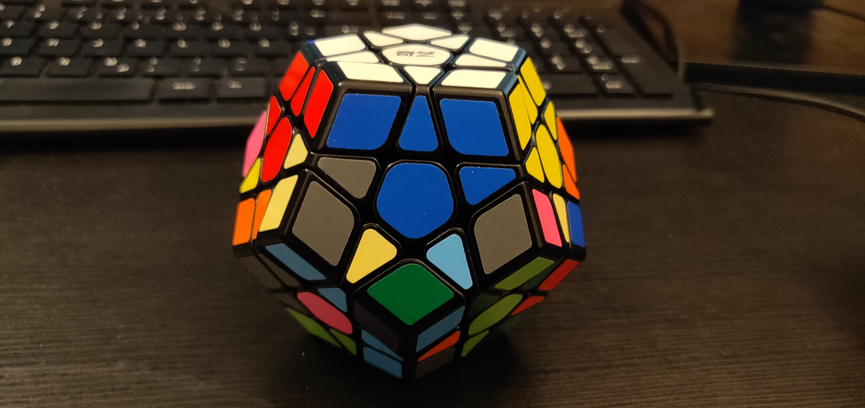
Goals
Goal 32
Moves: -r_v

Slide 16
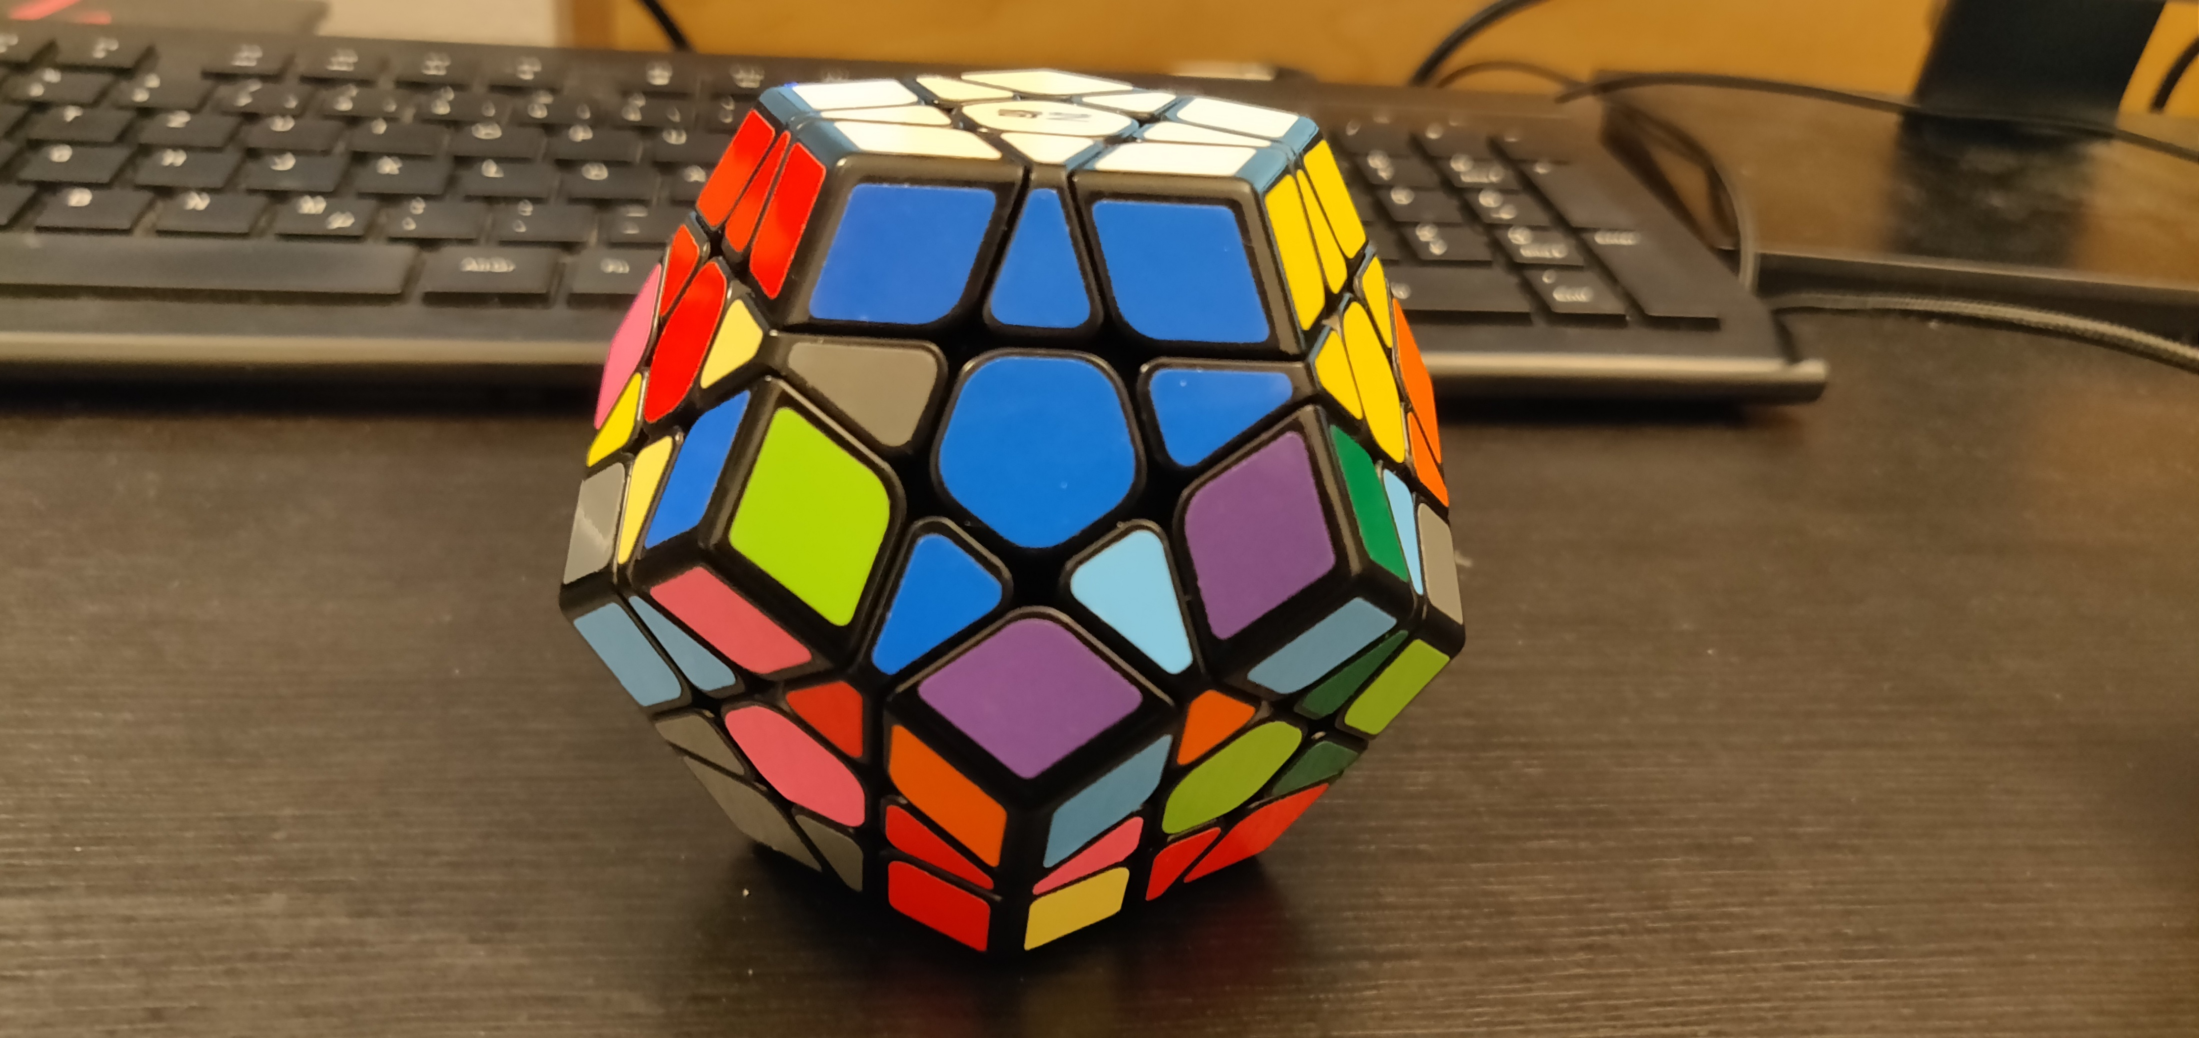
Goals
Goal 33
Moves: all

Slide 17
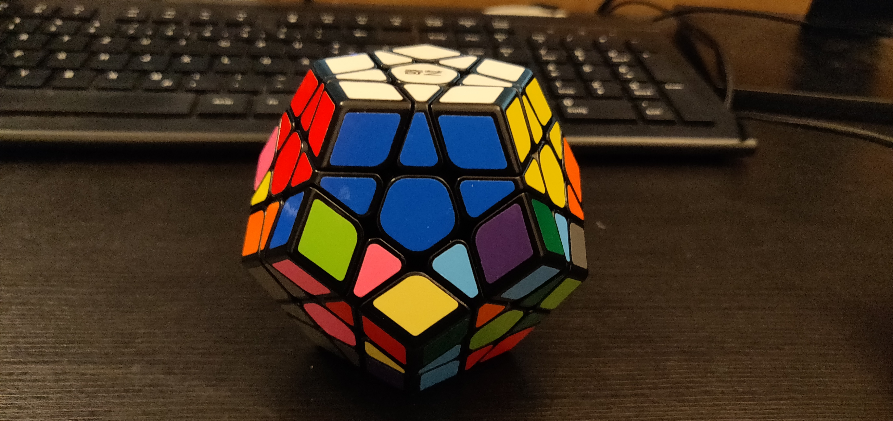
Goals
Goal 34
Moves: Sp2

Slide 18
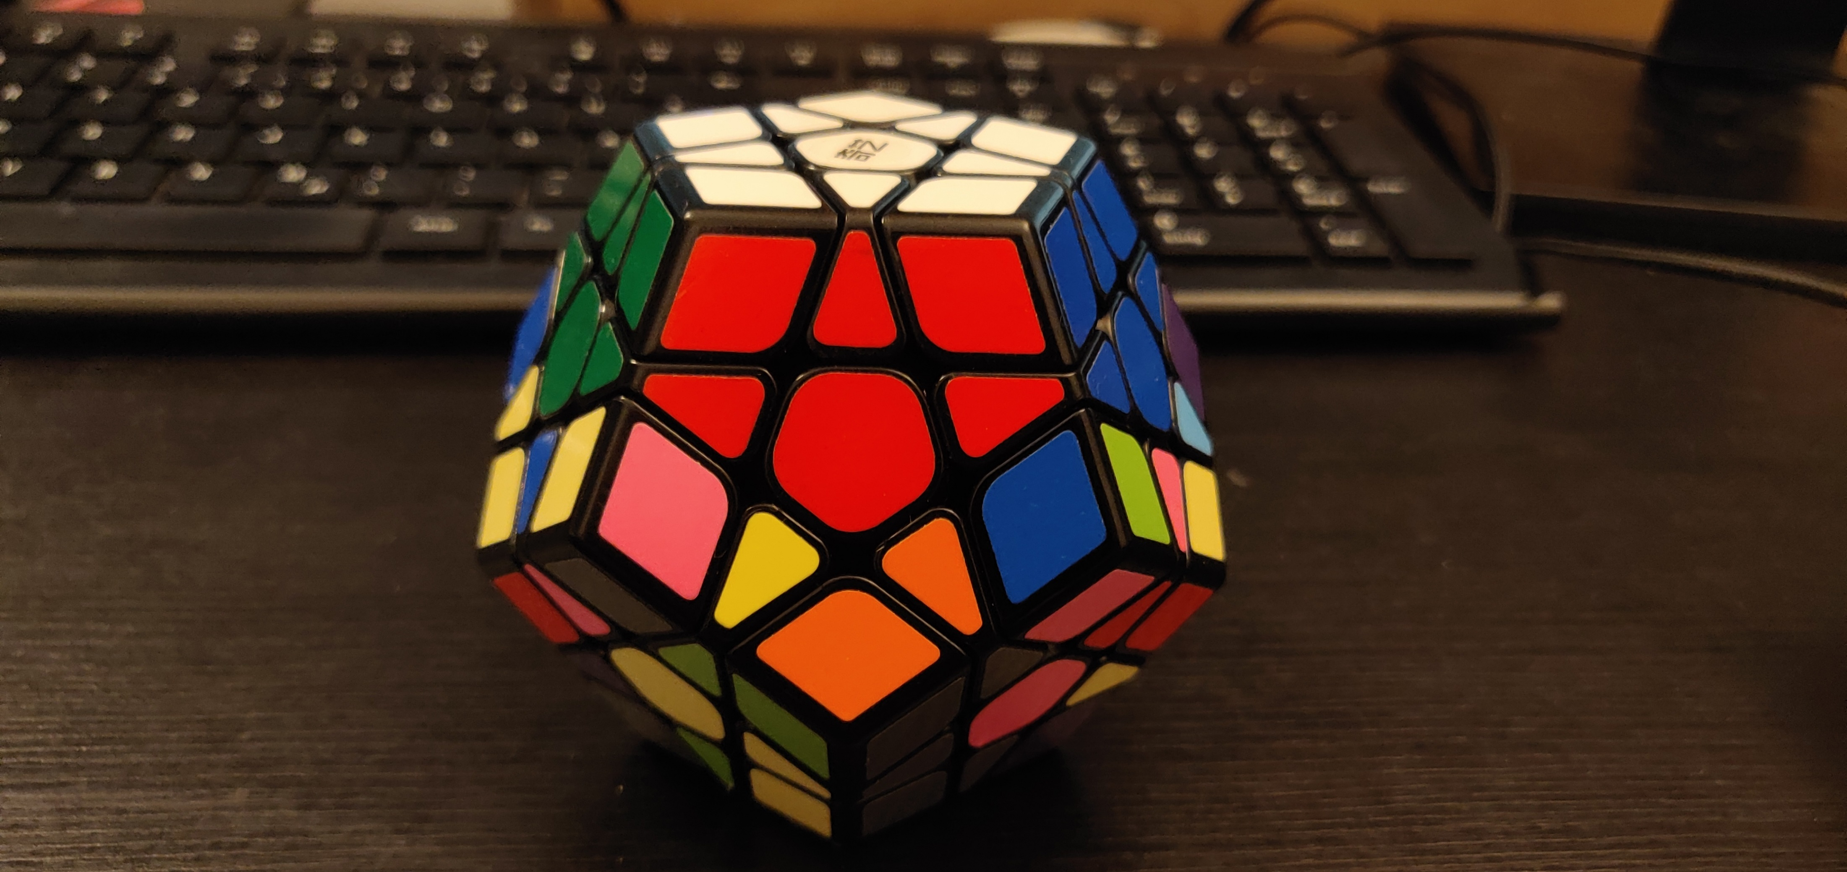
Goals
Goal 35
Moves: -r_v

Slide 19
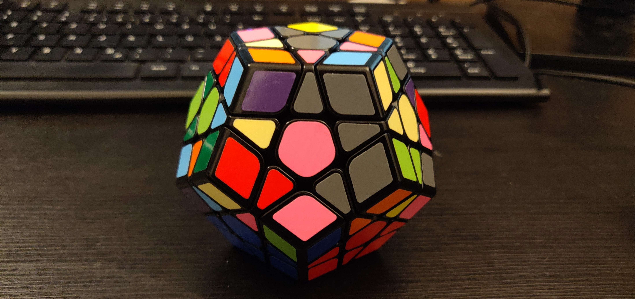
Goals
Goal 36
Moves: r_ud

